Slide 1
Workload Profile Assessment for VNX
SJEMCDEV01 As of 2015-02-01

Slide 2
Agenda
This Storage Assessment is organized in the following sections:
Summary
Utilization
Configuration
Performance
Top LUNs
The following additional files were provided:
Detail Slides.pptx: Detailed per-LUN charts
Details.xlsx: Additional detailed information
LUN Mapping Details.vdx: Visio diagram of layout and mapping
Time Frame: 2015-01-31 14:04:51.0 thru 2015-02-01 02:54:51.0 {TIMEZONE}

Slide 3
Summary
Name | Model | # SPs | # Ports | # of Bound Disks (non-EFD) | # of Bound EFDs | # RAID Groups
APM00140712253 | VNX5800 | 2 | 24 | 97 | 9 | 0
Notes:
Response time shown is a weighted average of LUN response times. This is not the same as SP response time, which includes MirrorView and SnapView operations.
Unbound Disks, Hot Spares and empty Raid Groups may be excluded.

Slide 4
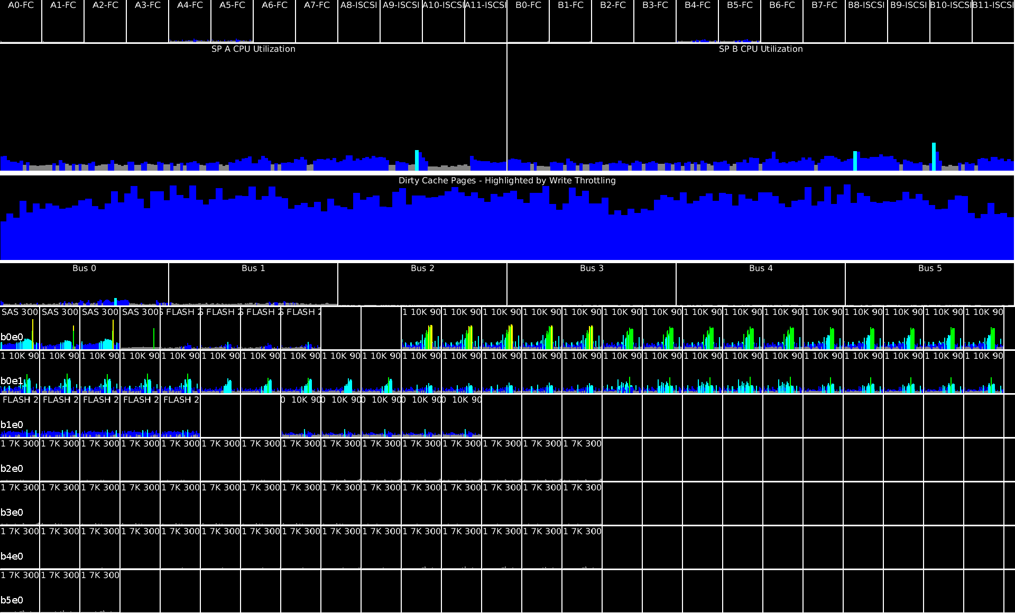
Heat Map
Notes:
Rockies
Color key:
Blue: 0-19% utilization
Cyan: 20-39% Utilization
Green: 40-59% utilization
Yellow: 60-79% utilization
Orange: 80-89% utilization
Red: 90-100% utilization
Top row shows port utilization, as a percentage of max bandwidth / port bandwidth. Port bandwidth is based on the currently negotiated bandwidth: ports may be capable of higher throughput. Max Bandwidth is the maximum of read or write bandwidth: this shows the maximum utilization in either direction.
The second row shows the SP Processor Utilization.
The third row depends on the FLARE Operating Environment version running on the system
For pre-OE 33 (pre-VNX2) environments, this section shows the SP Dirty Pages Utilization %. Each SP maintains a separate cache, therefore two caches are shown
For OE 33 (Rockies) and above, the SP Caches are unified, therefore the total SP Dirty Pages in MB is shown (the maximum of the values from each SP). The SP Dirty Pages are color coded according to the amount of Write Throttling: fewer than 10 write throttles per sec = blue, up to 50 then cyan, up to 100 then green, up to 200 then yellow, over 200 then orange.
These write throttle thresholds are chosen arbitrarily, to show the amount of cache activity within the system. It's expected and normal that a busy system will show more requests than an idle system
The fourth row shows bus utilization. This is calculated using the total disk bandwidth (MB/sec) for all disks on a given bus, and assumes a 4Gb/sec bus speed for CX systems and 6x4 Gb/sec bus speed for VNX systems. If the model is undetected, the model is assumed to be a CX.
The final set of rows shows disk utilization for each individual disk. Each disk is identified by three indicators: Raid Group, Speed, and Size. FC for the Raid Group value indicates a FAST Cache device. Each row represents a bus and target, identified by the leftmost label: b0e1 is Bus 0, Enclosure 1

Slide 5
Array Capacity
Notes:
The following chart shows the breakdown of storage capacity, starting with physical disk capacity, then overall physical and Usable Raid Group/Pool capacity, then finally configured (subscribed) LUN capacity.
Public=Public RaidGroup LUN Capacity
Pool Public= Pool Public LUN Capacity
Thin=Thin LUN Capacity

Slide 6
System Summary
Metric | Value | Comments
Model | VNX5800
FLARE | 7.33.3.0.74
Disk Capacity | 181 TiB, 97 disks | NL 7K 3000GB - 48 disks, SAS 10K 900GB - 45 disks, SAS SAS 300GB - 4 disks (excl. EFD, unbound and spares)
SSD/EFD Capacity | 1.76 TiB, 9 drives | FLASH 200GB - 9 drives
Configured LUN Capacity | 52 TiB over 137 LUNs
Front End IOPS - avg | 4881 | Read + Write
Front End IOPS - 95th | 8037 | Read + Write
Front End IOPS - max | 10384 | Read + Write
Avg IO Size (KB) | 28 | Read and Write
% Reads | 49 | Front End Reads / (Reads + Writes)
Snap Sessions | 0 Sessions
Async Mirrors | 0 Mirrors

Slide 7
Health Findings
Metric | Value | Health | Comments
SP CPU | SP B: 11%, SP A: 11% | Normal | Low CPU utilization - 95th
SP Cache Exceeds High Water |  | Normal | Cache rarely exceeds the high watermark
LUNs exceeding 20 Forced Flushes/Sec |  | Normal
LUNs exceeding 100ms |  | Normal
LUNs w/ high queuing (ABQL > 5) |  | Warning | High queuing indicates that response time may be improved with faster disk technology, such as SSD/EFD devices or by moving the LUNs to less busy disks.
LUNs w/ low utilization (1-5%) |  | Notice | Low utilization LUNs are good candidates for capacity-oriented disks
Idle LUNs (0% Utilization) |  | Notice | Idle LUNs are either capacity-oriented disk candidates, or are not yet used.

Slide 8
Input Files

Slide 9
Input Files
Filename | Start Date | End Date
APM00140712253_SPA_2015-02-01_02-57-28-GMT_M08-00.nar | 2015-01-31 14:04 | 2015-02-01 02:54

Slide 10
IOPS Analysis

Slide 11
Front End LUN vs Back End Disk
Notes:
The top chart shows the LUN IOPS.
The middle chart shows EFD IOPS. This includes FAST Cache activity, as well as any other EFD devices in the system.
The bottom chart shows non-EFD Disk IOPS. Note that
Notes: All IOPS are shown as Reads + Writes. Back end IOPS excludes any cache hits, but includes RAID overhead and any other overhead source, including but not limited to snapshots and mirroring.

Slide 12
Back End IOPS by Drive Type
Drive Type | RAID Type | # Disks | Usable (TB) | % of IOPS | Total IOPS - avg | Read IOPS - avg | Write IOPS - avg | Response Time (ms) - avg
FAST Cache |  | 4 |  | 29 | 1,458 | 332 | 1,126 | 0
FLASH 200 | Unknown | 5 | 1 | 43 | 2,213 | 1,442 | 771 | 2
SAS 300 |  | 4 |  | 4 | 223 | 117 | 106 | 2
10K 900 | RAID5,Unknown | 45 | 29 | 23 | 1,183 | 672 | 512 | 11
7K 3000 | Unknown | 48 | 97 | 0 | 16 | 11 | 5 | 16
Back End IOPS are shown here. RAID-5/6 devices will show higher relative values than RAID-1 devices.

Slide 13
Back End IOPS by Drive Type - Cont'd

Slide 14
Front End IOPS Skew
86% of IOs are processed by 15% of LUNs.
Notes:
This chart shows the average IOPS for each LUN, in descending order. The line chart shows the cumulative % of total system IOPS as the LUNs increase.
Each column is a separate LUN, showing the average IOPS for each LUN.
Note: This chart hides private/meta component LUNs

Slide 15
Front End IOPS by Host
VBSMBDPRD_Data_RPTGT_4
DW_DATA_RPTGT_7
SAPPRD_RPTGT_DA
VBSMBDPRD_Dat
BSMDBPRD_RP2T
RELDBPRD_RPT
sjemcrpa01, sjemcrpa02
sapqas01
bsmdbqa01
DW_DATA_R
VBSMDBPR
CDS_LINU
VBSMD
SAPQA
sjsqlqa10
BSMDBPRD_RP2TGT_0
SAPPRD_RPTGT_LO
sapsb
DW_DA
SAPQA
SAPQ
SAP
VBS
SAP
bsmtest
DW_DATA_R
bsm
CDS
sjs
VB
CD
SA
BS
vbsmdbqa
CDS_LIN
SA
BS
SA
V
V
S
reldbdev
VBSMDBPRD_Data_RPT
INFRADB_RPTGT_2
DW_
SAP
SAPQAS
SA
bs
vb
VB
re
C
cdsdbqa
DW_DATA_R
SAP
SA
VB
C
C
S
D
R
DW_
cd
IN
R
S
armstg01
DW_DA
SAP
VB
SA
IN
sj
S
I
DW_
BSM
IN
R
d
dwdbqa
SA
SA
S
c
S
Notes:
lun: VBSMBDPRD_Data_RPTGT_4 , iops_avg: 1443.96 , clients: sjemcrpa01, sjemcrpa02
lun: DW_DATA_RPTGT_7 , iops_avg: 279.92 , clients: sjemcrpa01, sjemcrpa02
lun: BSMDBPRD_RP2TGT_0 , iops_avg: 277.33 , clients: sjemcrpa01, sjemcrpa02
lun: VBSMDBPRD_Data_RPTGT_5 , iops_avg: 259.04 , clients: sjemcrpa01, sjemcrpa02
lun: SAPPRD_RPTGT_DATA_7 , iops_avg: 254.86 , clients: sjemcrpa01, sjemcrpa02
lun: SAPPRD_RPTGT_LOG , iops_avg: 227.01 , clients: sjemcrpa01, sjemcrpa02
lun: INFRADB_RPTGT_2 , iops_avg: 197.05 , clients: sjemcrpa01, sjemcrpa02
lun: VBSMBDPRD_Data_RPTGT_3 , iops_avg: 164.29 , clients: sjemcrpa01, sjemcrpa02
lun: BSMDBPRD_RP2TGT_1 , iops_avg: 162.07 , clients: sjemcrpa01, sjemcrpa02
lun: RELDBPRD_RPTGT_1 , iops_avg: 148.86 , clients: sjemcrpa01, sjemcrpa02
lun: DW_DATA_RPTGT_5 , iops_avg: 133.15 , clients: sjemcrpa01, sjemcrpa02
lun: DW_DATA_RPTGT_4 , iops_avg: 104.15 , clients: sjemcrpa01, sjemcrpa02
lun: DW_DATA_RPTGT_3 , iops_avg: 88.89 , clients: sjemcrpa01, sjemcrpa02
lun: VBSMDBPRD_Data_RPTGT_1 , iops_avg: 81.53 , clients: sjemcrpa01, sjemcrpa02
lun: CDS_LINUX_Data_RPTGT_3 , iops_avg: 68.99 , clients: sjemcrpa01, sjemcrpa02
lun: VBSMDBPRD_Data_RPTGT_6 , iops_avg: 54.33 , clients: sjemcrpa01, sjemcrpa02
lun: SAPQAS_LINUX_Data_8 , iops_avg: 53.6 , clients: sapqas01
lun: DW_DATA_RPTGT_1 , iops_avg: 51.64 , clients: sjemcrpa01, sjemcrpa02
lun: CDS_LINUX_Data_RPTGT_1 , iops_avg: 47.74 , clients: sjemcrpa01, sjemcrpa02
lun: SAPQAS_LINUX_Data_7 , iops_avg: 46.15 , clients: sapqas01
lun: DW_DATA_RPTGT_6 , iops_avg: 45.97 , clients: sjemcrpa01, sjemcrpa02
lun: SAPQAS_LINUX_Data_4 , iops_avg: 39.4 , clients: sapqas01
lun: SAPQAS_LINUX_Data_3 , iops_avg: 36.58 , clients: sapqas01
lun: SAPPRD_RPTGT_App , iops_avg: 28.72 , clients: sjemcrpa01, sjemcrpa02
lun: VBSMBDPRD_Data_RPTGT_2 , iops_avg: 28.31 , clients: sjemcrpa01, sjemcrpa02
lun: SAPPRD_RPTGT_DATA_4 , iops_avg: 28.17 , clients: sjemcrpa01, sjemcrpa02
lun: bsmdbqa01_lun00 , iops_avg: 26.36 , clients: bsmdbqa01
lun: DW_DATA_RPTGT_2 , iops_avg: 25.51 , clients: sjemcrpa01, sjemcrpa02
lun: DW_DATA_JVOL_6 , iops_avg: 21.29 , clients: sjemcrpa01, sjemcrpa02
lun: DW_DATA_JVOL_5 , iops_avg: 21.25 , clients: sjemcrpa01, sjemcrpa02
lun: CDS_LINUX_Data_RPTGT_2 , iops_avg: 20.11 , clients: sjemcrpa01, sjemcrpa02
lun: SAPPRD_RPTGT_DATA_5 , iops_avg: 16.3 , clients: sjemcrpa01, sjemcrpa02
lun: SAPQAS_LINUX_Data_6 , iops_avg: 15.36 , clients: sapqas01
lun: SAPPRD_RPTGT_DATA_2 , iops_avg: 15.18 , clients: sjemcrpa01, sjemcrpa02
lun: BSMDBPRD_RP2TGT_2 , iops_avg: 14.6 , clients: sjemcrpa01, sjemcrpa02
lun: sjsqlqa10-data , iops_avg: 12.77 , clients: sjsqlqa10
lun: VBSMDBPRD_TGT_JVOL_2 , iops_avg: 12.52 , clients: sjemcrpa01, sjemcrpa02
lun: CDS_LINUX_Data_RPTGT_4 , iops_avg: 12.37 , clients: sjemcrpa01, sjemcrpa02
lun: SAPPRD_RPTGT_DATA_3 , iops_avg: 12.06 , clients: sjemcrpa01, sjemcrpa02
lun: BSMDBPRD_2TGT_JVOL_1 , iops_avg: 11.52 , clients: sjemcrpa01, sjemcrpa02
lun: SAPPRD_RPTGT_DATA_6 , iops_avg: 11.38 , clients: sjemcrpa01, sjemcrpa02
lun: SAPSB-LINUX-App , iops_avg: 10.78 , clients: sapsb
lun: SAPQAS_LINUX_Data_5 , iops_avg: 10.77 , clients: sapqas01
lun: VBSMDBPRD_TGT_JVOL_1 , iops_avg: 10.68 , clients: sjemcrpa01, sjemcrpa02
lun: SAPQAS_LINUX_App , iops_avg: 10.42 , clients: sapqas01
lun: BSMDBPRD_2TGT_JVOL_2 , iops_avg: 10.33 , clients: sjemcrpa01, sjemcrpa02
lun: SAPPRD_RPTGT_DATA_1 , iops_avg: 10.09 , clients: sjemcrpa01, sjemcrpa02
lun: VBSMDBPRD_TGT_JVOL_6 , iops_avg: 8.95 , clients: sjemcrpa01, sjemcrpa02
lun: VBSMDBPRD_TGT_JVOL_5 , iops_avg: 8.9 , clients: sjemcrpa01, sjemcrpa02
lun: SAPPRD_TGT_JVOL_9 , iops_avg: 8.82 , clients: sjemcrpa01, sjemcrpa02
lun: bsmtest-data_1 , iops_avg: 8.52 , clients: bsmtest
lun: VBSMDBPRD_TGT_JVOL_3 , iops_avg: 8.44 , clients: sjemcrpa01, sjemcrpa02
lun: SAPSB-LINUX_Data_8 , iops_avg: 8.16 , clients: sapsb
lun: INFRADB_TGT_JVOL_1 , iops_avg: 7.41 , clients: sjemcrpa01, sjemcrpa02
lun: SAPSB-LINUX_Data_6 , iops_avg: 6.94 , clients: sapsb
lun: vbsmdbqa_data1 , iops_avg: 6.92 , clients: vbsmdbqa
lun: VBSMDBPRD_TGT_JVOL_9 , iops_avg: 6.6 , clients: sjemcrpa01, sjemcrpa02
lun: reldbdev-data2 , iops_avg: 6.35 , clients: reldbdev
lun: CDS_LINUX_TGT_JVOL_2 , iops_avg: 6.3 , clients: sjemcrpa01, sjemcrpa02
lun: CDS_LINUX_TGT_JVOL_3 , iops_avg: 6.27 , clients: sjemcrpa01, sjemcrpa02
lun: cdsdbqa_lun4 , iops_avg: 6.24 , clients: cdsdbqa
lun: INFRADB_TGT_JVOL_2 , iops_avg: 6.08 , clients: sjemcrpa01, sjemcrpa02
lun: RELDBPRD_TGT_JVOL_2 , iops_avg: 5.78 , clients: sjemcrpa01, sjemcrpa02
lun: SAPPRD_TGT_JVOL_8 , iops_avg: 5.65 , clients: sjemcrpa01, sjemcrpa02
lun: CDS_LINUX_TGT_JVOL_1 , iops_avg: 5.3 , clients: sjemcrpa01, sjemcrpa02
lun: SAPPRD_RPTGT_DATA_8 , iops_avg: 5.14 , clients: sjemcrpa01, sjemcrpa02
lun: DW_DATA_JVOL_4 , iops_avg: 5.08 , clients: sjemcrpa01, sjemcrpa02
lun: RELDBPRD_RPTGT_4 , iops_avg: 4.97 , clients: sjemcrpa01, sjemcrpa02
lun: INFRADB_RPTGT_1 , iops_avg: 4.87 , clients: sjemcrpa01, sjemcrpa02
lun: RELDBPRD_TGT_JVOL_1 , iops_avg: 4.66 , clients: sjemcrpa01, sjemcrpa02
lun: SAPPRD_TGT_JVOL_4 , iops_avg: 3.85 , clients: sjemcrpa01, sjemcrpa02
lun: DW_DATA_JVOL_3 , iops_avg: 3.8 , clients: sjemcrpa01, sjemcrpa02
lun: sjarmstg01_data1_700gb , iops_avg: 3.7 , clients: armstg01
lun: dwdbqa_linux_2 , iops_avg: 3.46 , clients: dwdbqa
lun: cdsdbqa_lun_2 , iops_avg: 3.39 , clients: cdsdbqa
lun: SAPSB-LINUX_Data_2 , iops_avg: 2.9 , clients: sapsb
lun: SAPSB-LINUX_Data_7 , iops_avg: 2.79 , clients: sapsb
lun: RELDBPRD_RPTGT_2 , iops_avg: 2.23 , clients: sjemcrpa01, sjemcrpa02
lun: INFRADB_RPTGT_3 , iops_avg: 2.17 , clients: sjemcrpa01, sjemcrpa02
lun: bsmdbqa01_lun01 , iops_avg: 1.96 , clients: bsmdbqa01
lun: SAPSB-LINUX_Data_4 , iops_avg: 1.95 , clients: sapsb
lun: SAPSB-LINUX_Data_5 , iops_avg: 1.95 , clients: sapsb
lun: VBSMDBPRD_TGT_JVOL_4 , iops_avg: 1.89 , clients: sjemcrpa01, sjemcrpa02
lun: SAPPRD_TGT_JVOL_7 , iops_avg: 1.71 , clients: sjemcrpa01, sjemcrpa02
lun: DW_DATA_JVOL_2 , iops_avg: 1.7 , clients: sjemcrpa01, sjemcrpa02
lun: SAPPRD_TGT_JVOL_1 , iops_avg: 1.7 , clients: sjemcrpa01, sjemcrpa02
lun: SAPPRD_TGT_JVOL_3 , iops_avg: 1.7 , clients: sjemcrpa01, sjemcrpa02
lun: SAPPRD_TGT_JVOL_6 , iops_avg: 1.7 , clients: sjemcrpa01, sjemcrpa02
lun: DW_DATA_JVOL_1 , iops_avg: 1.69 , clients: sjemcrpa01, sjemcrpa02
lun: SAPPRD_TGT_JVOL_5 , iops_avg: 1.69 , clients: sjemcrpa01, sjemcrpa02
lun: SAPPRD_TGT_JVOL_2 , iops_avg: 1.68 , clients: sjemcrpa01, sjemcrpa02
lun: UDW_DATA_7 , iops_avg: 1.61 , clients: dwdbqa
lun: sjarmstg01_data4 , iops_avg: 1.54 , clients: armstg01
lun: bsmtest-data_2 , iops_avg: 1.38 , clients: bsmtest
lun: UDW_DATA_4 , iops_avg: 1.3 , clients: dwdbqa
lun: VBSMDBPRD_TGT_JVOL_8 , iops_avg: 1.06 , clients: sjemcrpa01, sjemcrpa02
lun: VBSMDBPRD_TGT_JVOL_7 , iops_avg: 1.06 , clients: sjemcrpa01, sjemcrpa02
lun: cdsdbqa_lun_1 , iops_avg: 0.98 , clients: cdsdbqa
lun: SAPSB-LINUX_Data_1 , iops_avg: 0.98 , clients: sapsb
lun: RELDBPRD_RPTGT_3 , iops_avg: 0.98 , clients: sjemcrpa01, sjemcrpa02
lun: dwdbqa_linux_1 , iops_avg: 0.79 , clients: dwdbqa
lun: SAPSB-LINUX_Data_3 , iops_avg: 0.63 , clients: sapsb
lun: sjarmstg01_data3_700gb , iops_avg: 0.61 , clients: armstg01
lun: dwdbqa_linux4 , iops_avg: 0.45 , clients: dwdbqa
lun: dwdbqa_linux3 , iops_avg: 0.43 , clients: dwdbqa
lun: UDW_DATA_6 , iops_avg: 0.39 , clients: dwdbqa
lun: UDW_DATA_5 , iops_avg: 0.38 , clients: dwdbqa
lun: sjsqlqa10-backup , iops_avg: 0.24 , clients: sjsqlqa10
lun: UDW_DATA_3 , iops_avg: 0.2 , clients: dwdbqa
lun: SAPQAS_LINUX_Archive , iops_avg: 0.15 , clients: sapqas01
lun: SAPPRD_RPTGT_Ora , iops_avg: 0.09 , clients: sjemcrpa01, sjemcrpa02
lun: RELDBPRD_RPTGT_5 , iops_avg: 0.08 , clients: sjemcrpa01, sjemcrpa02
lun: RELDBPRD_TGT_JVOL_3 , iops_avg: 0.07 , clients: sjemcrpa01, sjemcrpa02
lun: RELDBPRD_TGT_JVOL_4 , iops_avg: 0.07 , clients: sjemcrpa01, sjemcrpa02
lun: UDW_DATA_1 , iops_avg: 0.02 , clients: dwdbqa
lun: reldbdev-data1 , iops_avg: 0.02 , clients: reldbdev
lun: DW_DATA_RPTGT_9 , iops_avg: 0.02 , clients: sjemcrpa01, sjemcrpa02
lun: DW_DATA_RPTGT_8 , iops_avg: 0.02 , clients: sjemcrpa01, sjemcrpa02
lun: SAPPRD_RPTGT_DATA_9 , iops_avg: 0.02 , clients: sjemcrpa01, sjemcrpa02
lun: SAPQAS_LINUX_ORA , iops_avg: 0.01 , clients: sapqas01
lun: sjarmstg01_data2_700gb , iops_avg: 0 , clients: armstg01
lun: UDW_DATA_2 , iops_avg: 0 , clients: dwdbqa
lun: cdsdbqa_lun_3 , iops_avg: 0 , clients: cdsdbqa
lun: SAPQAS_LINUX_Data_1 , iops_avg: 0 , clients: sapqas01
lun: SAPQAS_LINUX_Data_2 , iops_avg: 0 , clients: sapqas01
lun: vbsmdbqa_data2 , iops_avg: 0 , clients: vbsmdbqa
lun: infradbqas_data_0 , iops_avg: 0 , clients: infradbqas
lun: infradbqas_data_2 , iops_avg: 0 , clients: infradbqas
lun: infradbqas_data_1 , iops_avg: 0 , clients: infradbqas
lun: BSMDBPRD_RPTGT_0 , iops_avg: 0 , clients: bsmdbqa01
lun: BSMDBPRD_RPTGT_2 , iops_avg: 0 , clients: bsmdbqa01
lun: BSMDBPRD_RPTGT_1 , iops_avg: 0 , clients: bsmdbqa01
lun: sjarmstg01_data5 , iops_avg: 0 , clients: armstg01
lun: bsm-upgradeshare , iops_avg: 0 , clients: bsmdbqa01
lun: SAPSB-LINUX-ORA , iops_avg: 0 , clients: sapsb
lun: LUN 400 , iops_avg: 0 , clients: sjemcrpa01, sjemcrpa02
lun: sjsqlqa10-log , iops_avg: 0 , clients: sjsqlqa10

Slide 16
Front End IOPS Projections
Metric | IOPS | Required EFD Devices | Required 15K Spindles
RAID-10 Adjusted IOPS - Peak | 15,642 | 7 | 87
RAID-5 Adjusted IOPS - Peak | 26,156 | 11 | 146
RAID-10 Adjusted IOPS - 95th | 12,129 | 5 | 68
RAID-5 Adjusted IOPS - 95th | 20,217 | 9 | 113
The drive estimates on this page are RAID-Adjusted Front End IOPS. Caching, mirroring, snapshots and other factors are not considered.
Notes:
This is a rough calculation using RAID-adjusted IOPS to determine the minimum number of drives required to meet the IOPS threshold. Capacity is not taken into consideration; typically more drives will be needed to meet capacity requirements. Exact configuration, including mirroring and snapshots, will impact overall requirements.
This table is calculated by analyzing the total IOPS (read + write), and estimating the number of required spindles to sustain the workload. Note that these sizing estimates use typical sustained (not burst) IOPS for each tier of disks.
For example,
7.2K RPM spindles are estimated to sustain 80 IOPs
10K RPM spindles are estimated to sustain 130 IOPs
15K spindles are estimated to sustain 180 IOPs
EFD devices are estimated to sustain 2500 and 5000 IOPs. 2500 IOPS per EFD device is used in the following calculations.
The total Backend IOPs workload is a function of the front-end (host) workload and the RAID overhead using these formulas:
R5: Raid-Adjusted IOPs = (IOPs * Read %) + ((IOPs * Write %) * 4)
R10: Raid-Adjusted IOPs = (IOPs * Read %) + ((IOPs * Write %) * 2)
For example, a database server with a peak of approximately 389 Read IOPs and 419 Write IOPs in an R10 configuration would need to support approximately 808 back-end disk IOPs, which translates into a minimum of eight 10K spindles or six 15K spindles (this calculation does not take into consideration storage requirements).
EMC allows customers to mix high-performance and high-capacity drives to optimize performance, density, cost and energy efficiency. Today these storage tiers include the unparalleled performance advantage of solid state technology based Enterprise Flash Drives (EFD) drives and the energy savings of low power drives. The introduction of high performance EFD drives provides substantial power savings for I/O-intensive applications, consuming 98% less energy per I/O transaction than an equivalent array of 15K FC drives. For capacity-intensive and streaming applications the choice of low power drives will consume 32% less energy than traditional 7,200 rpm drives.

Slide 17
IO classification
Classification | Peak IOPS | Total (TiB) | # Luns
Large IO (128KB+) | 422 | 1 | 4
Low Utilization | 5,606 | 26 | 120
Other | 7,742 | 4 | 12
Small IO + mostly reads: EFD | 280 |  | 1
Experimental Report. Caution is advised. Refer to IO Classification worksheet for details.
Notes:
Note: Peak IOPS is the maximum IOPS at any point in time for all the LUNs in this group. This is not the sum of each LUNs taken individually.

Slide 18
FAST Cache

Slide 19
FAST Cache Summary
Name | FAST Cache | # LUNs - Enabled | Read IOPS - avg | Write IOPS - avg | FAST Cache Read Hit Ratio - avg | FAST Cache Write Hit Ratio - avg
Pool 0 - Recoverpoint JVol | ENABLED | 21 | 32 | 84 | 6 | 1
Pool 1 | ENABLED | 116 | 2,371 | 2,394 | 59 | 64
Notes:
This table is based on front-end IOPS, and does not take into consideration RAID overhead for IO misses.

Slide 20
FAST Cache Pool 0 - Recoverpoint JVol

Slide 21
FAST Cache Pool 1

Slide 22
SP FAST Cache

Slide 23
Back End IO Analysis

Slide 24
IOs by Pool & Tier
Parent | Drive Type | RAID Type | # Disks | Total IOPS - avg | Read IOPS - avg | Write IOPS - avg | Response Time (ms) - avg | Service Time (ms) - avg
 | SAS 300 |  | 4 | 223 | 117 | 105.86 | 2.03 | 2
FAST Cache | FLASH 200 |  | 4 | 1,458 | 332 | 1,126.01 | 0.24 | 0
Pool 0 - Recoverpoint JVol | 10K 900 | RAID5 | 5 | 81 | 23 | 58.49 | 18.21 | 3
Pool 1 | 10K 900 | Unknown | 40 | 1,102 | 649 | 453.01 | 10.31 | 4
Pool 1 | 7K 3000 | Unknown | 48 | 16 | 11 | 4.89 | 15.60 | 7
Pool 1 | FLASH 200 | Unknown | 5 | 2,213 | 1,442 | 770.90 | 1.96 | 0
Notes:
IOPS shown are backend IOPS, after RAID and other overhead.

Slide 25
Back End Balance
Notes:
Top chart shows average IOPS per Pool or Raid Group.
Middle chart shows average IOPS for each disk in the system.
Bottom chart shows average utilization for each disk in the system.
Note: FAST Cache disks are excluded.

Slide 26
Pool - Private Raid Group Balance Pool 0 - Recoverpoint JVol

Slide 27
Pool - Private Raid Group Balance Pool 1

Slide 28
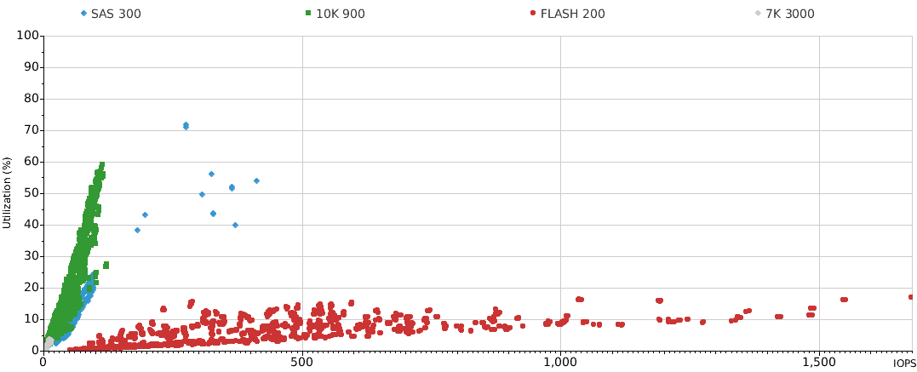
Drive IOPS vs Utilization
Flash drives show the lowest utilization, up to thousands of IOPS. Disk drives will sustain hundreds of IOPS.

Slide 29
Capacity and Configuration

Slide 30
Free Space

Slide 31
Configuration
Name | Model | FLARE | Write Cache Enabled | Write Cache Mirror | FAST Cache | FAST Cache Mode | FAST Cache Size (GB)
APM00140712253 | VNX5800 | 7.33.3.0.74 | ENABLED | ENABLED | ENABLED | READ & WRITE | 366
Name | Stat Logging | Read Cache | Write Cache | Phys Mem Size
SP B | ON | ENABLED | ENABLED | 32768
SP A | ON | ENABLED | ENABLED | 32768
Name | Utilization (%) - avg | Utilization (%) - 95th | Read MB/sec - 95th | Write MB/sec - 95th | Read IOPS - 95th | Total IOPS - 95th | Read Size (KB) - avg | Write Size (KB) - avg
SP B | 7 | 11 | 64 | 82 | 2,401 | 4,686 | 19 | 23
SP A | 6 | 11 | 89 | 77 | 1,868 | 3,712 | 43 | 40

Slide 32
Raid Groups and Pools
Subsystem | Name | RAID Type | FAST Cache | # Disks | Raw (TiB) | Usable (TiB) | Consumed (TiB) | Drive Type
APM00140712253 | Pool 1 | Unknown | ENABLED | 93 | 164.46 | 123.07 | 47.71 | 10K 900, 7K 3000, FLASH 200
APM00140712253 | Pool 0 - Recoverpoint JVol | RAID5 | ENABLED | 5 | 4.07 | 3.20 | 3.09 | 10K 900
 |  |  |  | 98 | 168.53 | 126.28 | 50.80

Slide 33
Storage Groups
Hosts | # Luns | # RGs or Pools | RGs/Pools | LUN Types | LUN Capacity (GB) | Consumed (GB) | Total IOPS - avg
sjemcrpa01, sjemcrpa02 | 78 | 2 | Pool 0 - Recoverpoint JVol, Pool 1 | Pool Public LUN, Thin LUN | 24,374 | 26,429 | 4,541
sapqas01 | 11 | 1 | Pool 1 | Thin LUN |  | 4,734 | 212
sapsb | 10 | 1 | Pool 1 | Thin LUN |  | 5,419 | 37
bsmdbqa01 | 6 | 1 | Pool 1 | Pool Public LUN, Thin LUN | 1,741 | 2,437 | 28
sjsqlqa10 | 3 | 1 | Pool 1 | Thin LUN |  | 406 | 13
cdsdbqa | 4 | 1 | Pool 1 | Thin LUN |  | 816 | 11
bsmtest | 2 | 1 | Pool 1 | Thin LUN |  | 515 | 10
dwdbqa | 11 | 1 | Pool 1 | Pool Public LUN, Thin LUN | 5,530 | 7,701 | 9
vbsmdbqa | 2 | 1 | Pool 1 | Thin LUN |  | 473 | 7
reldbdev | 2 | 1 | Pool 1 | Thin LUN |  | 353 | 6
armstg01 | 5 | 1 | Pool 1 | Thin LUN |  | 3,774 | 6
infradbqas | 3 | 1 | Pool 1 | Thin LUN |  | 8 | 0

Slide 34
SP LUN Summary
Owner | Type | # Luns | Capacity (GB)
SP A | Pool Public LUN | 42 | 15,233
SP A | Thin LUN | 27 | 10,301
SP B | Pool Public LUN | 38 | 15,670
SP B | Thin LUN | 30 | 9,839
 |  | 137 | 51,043
Notes:
For thick LUNs, total allocated size is shown. For thin LUNs, consumed size is shown.

Slide 35
Disk Summary
Subsystem | Parent | Drive Type | kRPM | Size (GiB) | # Disks | Model
APM00140712253 |  | SAS |  | 300 | 4 | ST930065 CLAR300
APM00140712253 | Pool 1 | NL SAS | 7 | 3,000 | 48 | HUS72303CLAR3000
APM00140712253 | Pool 1 | SAS | 10 | 900 | 40 | HUC10909 CLAR900, ST990080 CLAR900
APM00140712253 | Pool 1 | SAS Flash VP |  | 200 | 5 | P410M200 CLAR200
APM00140712253 | FAST Cache | SAS Flash |  | 200 | 4 | SS162512 CLAR200
APM00140712253 | Pool 0 - Recoverpoint JVol | SAS | 10 | 900 | 5 | HUC10909 CLAR900

Slide 36
Ports
Name | Speed (GB/sec) | Read MB/sec - 95th | Write MB/sec - 95th
SP B10-ISCSI |  | 0 | 0
SP A6-FC |  | 0 | 0
SP A4-FC | 8 | 45 | 38
SP B1-FC | 8 | 2 | 0
SP B7-FC |  | 0 | 0
SP B4-FC | 8 | 29 | 40
SP A1-FC | 8 | 4 | 1
SP A11-ISCSI |  | 0 | 0
SP B2-FC |  | 0 | 0
SP A7-FC |  | 0 | 0
SP A5-FC | 8 | 44 | 36
SP B6-FC |  | 0 | 0
SP B9-ISCSI |  | 0 | 0
SP A10-ISCSI |  | 0 | 0
SP A3-FC |  | 0 | 0
SP A9-ISCSI |  | 0 | 0

Slide 37
Ports (Cont.)
Name | Speed (GB/sec) | Read MB/sec - 95th | Write MB/sec - 95th
SP A2-FC |  | 0 | 0
SP B0-FC | 8 | 2 | 0
SP B11-ISCSI |  | 0 | 0
SP B5-FC | 8 | 30 | 41
SP A0-FC | 8 | 4 | 1
SP A8-ISCSI |  | 0 | 0
SP B3-FC |  | 0 | 0
SP B8-ISCSI |  | 0 | 0

Slide 38
IO Size

Slide 39
IO Sizes

Slide 40
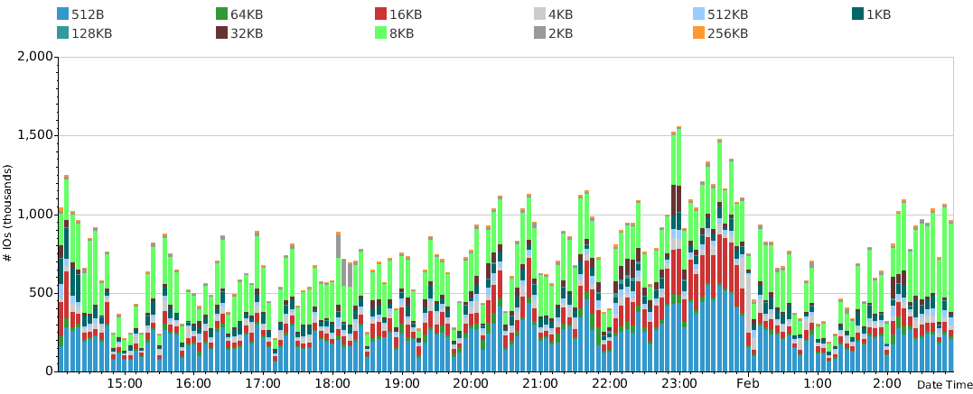
IO Sizes over Time (Reads)

Slide 41
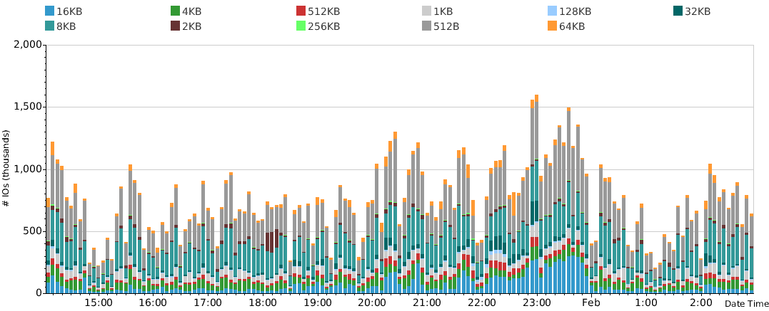
IO Sizes over Time (Writes)

Slide 42
Reads

Slide 43
Writes

Slide 44
SP Cache

Slide 45
Caching - SP Cache

Slide 46
SP Cache Hits

Slide 47
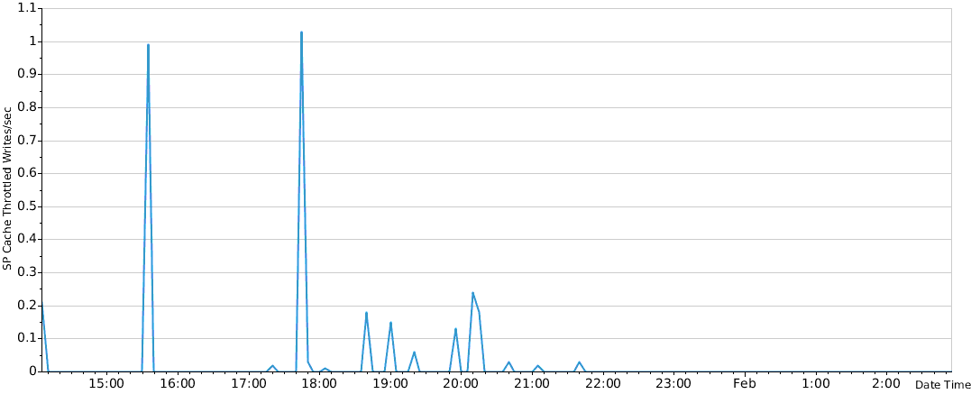
Cache Write Throttling

Slide 48
SP Response Time

Slide 49
Performance

Slide 50
SP Stats

Slide 51
SP Port Bandwidth

Slide 52
LUN Response Time
Notes:
Response times shown are weighted averages: sum(lun_iops * lun_responsetime)/sum(lun_iops) for all LUNs excluding Meta's.

Slide 53
Host IOPS and MB/sec

Slide 54
LUN Utilization
Notes:
This chart shows the utilization (95th percentile) for each LUN, in descending order.
Note: This chart hides private/meta component LUNs

Slide 55
Throughput vs Utilization

Slide 56
Top LUNs

Slide 57
Top LUNs by ABQL
LUN | Parent | ABQL - 95th | Read Size (KB) - 95th | Response Time (ms) - 95th | Service Time (ms) - 95th | Total IOPS - 95th | Utilization (%) - 95th | Write Size (KB) - 95th | Hosts
LUN 70 | Pool 1 | 35 | 16 | 4 | 0 | 797 | 5 | 16 | sjemcrpa01...
LUN 115 | Pool 1 | 34 | 40 | 5 | 0 | 106 | 2 | 40 | sjemcrpa01...
LUN 62 | Pool 1 | 34 | 17 | 5 | 0 | 449 | 4 | 17 | sjemcrpa01...
LUN 56 | Pool 1 | 34 | 9 | 3 | 0 | 261 | 2 | 7 | sjemcrpa01...
LUN 100 | Pool 1 | 34 | 34 | 5 | 0 | 579 | 5 | 34 | sjemcrpa01...
LUN 79 | Pool 1 | 34 | 7 | 3 | 0 | 2,453 | 14 | 6 | sjemcrpa01...
LUN 102 | Pool 1 | 34 | 56 | 13 | 1 | 48 | 1 | 57 | sjemcrpa01...
LUN 99 | Pool 1 | 34 | 5 | 3 | 0 | 889 | 8 | 5 | sjemcrpa01...
LUN 109 | Pool 1 | 32 | 64 | 7 | 0 | 414 | 7 | 65 | sjemcrpa01...
LUN 108 | Pool 1 | 32 | 61 | 9 | 0 | 362 | 10 | 61 | sjemcrpa01...
Average Busy Queue Length (ABQL) tells you the average # of IOs in the LUN request queue, excluding periods when the LUN was idle.

Slide 58
Top LUNs by Response Time
LUN | Parent | Response Time (ms) - 95th | Service Time (ms) - 95th | Total IOPS - 95th | SP Cache Forced Flushes/sec - 95th | SP Cache Forced Flushes/sec - max | Read Size (KB) - 95th | Write Size (KB) - 95th | Hosts
LUN 113 | Pool 1 | 13 | 1 | 94 | 0 | 0 | 496 | 490 | sjemcrpa01...
LUN 47 | Pool 1 | 12 | 1 | 51 | 0 | 0 | 56 | 57 | sjemcrpa01...
LUN 114 | Pool 1 | 12 | 1 | 94 | 0 | 0 | 498 | 490 | sjemcrpa01...
LUN 83 | Pool 1 | 10 | 1 | 60 | 0 | 0 | 495 | 490 | sjemcrpa01...
LUN 107 | Pool 1 | 10 | 1 | 118 | 0 | 0 | 61 | 61 | sjemcrpa01...
LUN 110 | Pool 1 | 9 | 0 | 694 | 0 | 0 | 48 | 49 | sjemcrpa01...
LUN 108 | Pool 1 | 9 | 0 | 362 | 0 | 0 | 61 | 61 | sjemcrpa01...
LUN 101 | Pool 1 | 8 | 1 | 183 | 0 | 0 | 45 | 45 | sjemcrpa01...
LUN 106 | Pool 1 | 7 | 0 | 239 | 0 | 0 | 40 | 41 | sjemcrpa01...
LUN 109 | Pool 1 | 7 | 0 | 414 | 0 | 0 | 64 | 65 | sjemcrpa01...
Response time is measured from the time the system received the request until it was completed.

Slide 59
Top LUNs by IOPS
LUN | Parent | Total IOPS - 95th | Total MB/sec - 95th | Utilization (%) - 95th | ABQL - 95th | Read % | Response Time (ms) - 95th | Write Size (KB) - 95th | Read Size (KB) - 95th | Hosts
LUN 79 | Pool 1 | 2,453 | 14 | 14 | 34 | 50 | 3 | 6 | 7 | sjemcrpa01...
LUN 105 | Pool 1 | 1,560 | 2 | 20 | 23 | 50 | 3 | 6 | 6 | sjemcrpa01...
LUN 99 | Pool 1 | 889 | 3 | 8 | 34 | 50 | 3 | 5 | 5 | sjemcrpa01...
LUN 70 | Pool 1 | 797 | 7 | 5 | 35 | 51 | 4 | 16 | 16 | sjemcrpa01...
LUN 110 | Pool 1 | 694 | 21 | 11 | 31 | 50 | 9 | 49 | 48 | sjemcrpa01...
LUN 100 | Pool 1 | 579 | 9 | 5 | 34 | 51 | 5 | 34 | 34 | sjemcrpa01...
LUN 82 | Pool 1 | 523 | 9 | 5 | 32 | 50 | 6 | 34 | 34 | sjemcrpa01...
LUN 53 | Pool 1 | 466 | 3 | 3 | 30 | 50 | 3 | 9 | 9 | sjemcrpa01...
LUN 62 | Pool 1 | 449 | 5 | 4 | 34 | 51 | 5 | 17 | 17 | sjemcrpa01...
LUN 78 | Pool 1 | 427 | 4 | 3 | 25 | 51 | 5 | 15 | 15 | sjemcrpa01...
Move busiest LUNs to SSD/EFDs. Use FAST Cache and FAST VP to maximize the SSD/EFD investment.
Notes:
Only LUNs with Total IOPS - 95th exceeding 50 IOPS are shown.

Slide 60
Top LUNs by MB/sec
LUN | Parent | Total MB/sec - 95th | Utilization (%) - 95th | ABQL - 95th | Response Time (ms) - 95th | Read % | Write Size (KB) - 95th | Read Size (KB) - 95th | SP Cache Forced Flushes/sec - 95th
LUN 113 | Pool 1 | 45 | 8 | 12 | 13 | 37 | 490 | 496 | 0
LUN 114 | Pool 1 | 45 | 8 | 12 | 12 | 37 | 490 | 498 | 0
LUN 258 | Pool 1 | 33 | 5 | 16 | 3 | 80 | 29 | 295 | 0
LUN 83 | Pool 1 | 28 | 5 | 13 | 10 | 36 | 490 | 495 | 0
LUN 110 | Pool 1 | 21 | 11 | 31 | 9 | 50 | 49 | 48 | 0
LUN 108 | Pool 1 | 20 | 10 | 32 | 9 | 50 | 61 | 61 | 0
LUN 104 | Pool 1 | 19 | 3 | 13 | 15 | 38 | 486 | 498 | 0
LUN 89 | Pool 0 - Recoverpoint JVol | 16 | 2 | 10 | 8 | 39 | 489 | 496 | 0
LUN 90 | Pool 0 - Recoverpoint JVol | 16 | 3 | 10 | 9 | 39 | 488 | 495 | 0
LUN 81 | Pool 0 - Recoverpoint JVol | 14 | 3 | 8 | 6 | 25 | 387 | 497 | 0

Slide 61
Thank You

